Slide 1

Flood Risk Prediction in Chikwawa: A Machine Learning-based Solution
GROUP 1 MEMBERS:
Zaheerah Abdulashid (BSDS 0123)
Lingalithu Kadewere (BSDS1323)
George Mapelera (BSDS 2123)
Rodrick Kapopo(BSVCA 1722)
Favour Kampangire(BSDS 1523)
Louis Mamsako(BSDS 2523)
Jonathan Banda (BSDS 0323)

Slide 2
ABSTRACT
Chikwawa district is highly prone to flooding, suffering repeated disasters.
This project proposes a machine learning-based flood prediction system using satellite and hydrological data to improve early warnings and reduce disaster impact.

Slide 3
BACKGROUND
Chikwawa lies in the lower shire valley, impacted by floods from heavy upstream rainfall. Extreme weather events such as cyclones idai (2019), ana (2022), and freddy (2023) have intensified flood frequency and severity.

Slide 4
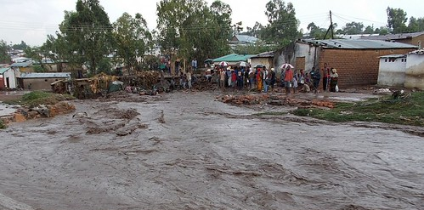
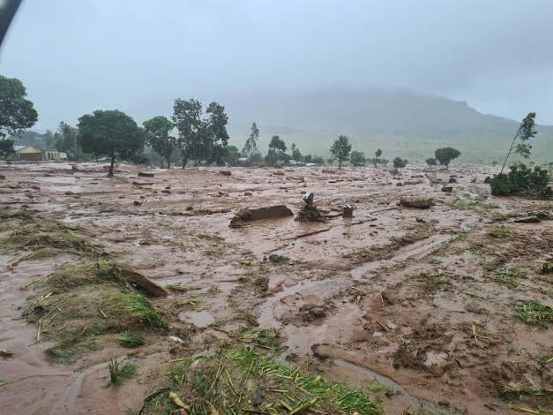
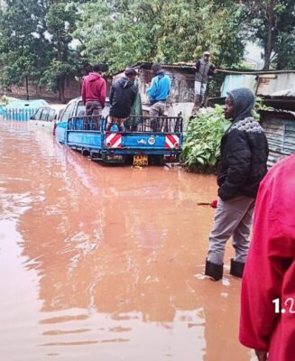
This Photo by Unknown Author is licensed under CC BY-NC-ND
This Photo by Unknown Author is licensed under CC BY-ND
This Photo by Unknown Author is licensed under CC BY-SA-NC

Slide 5
PROBLEM STATEMENT
Current early-warning systems lack precision and timeliness for chikwawa. Warnings are generic, rarely village-specific, and often delayed. A localized ml-based system is needed for accurate predictions and proactive disaster response.

Slide 6
OBJECTIVES
Main Objective
- Develop a machine learning-based flood risk prediction system for chikwawa.
Specific Objectives
To Identify key flood factors.
To Build predictive ml models.
To Assess flood impact on communities and infrastructure.

Slide 7
SCOPE
Focuses on Chikwawa District using:
- Hydrological data (river discharge)
- Meteorological data (rainfall)
- Geospatial data (DEM, land-use)
ML models will predict flood likelihood and severity.

Slide 8
METHODOLOGY
Research Design: Quantitative, data-driven.
Steps:
- Data collection
- Preprocessing & feature engineering
- Model development (random forest, lightgbm)
- Evaluation using accuracy metrics ( Precision, accuracy, recall, f1 score and confusion matrix)

Slide 9
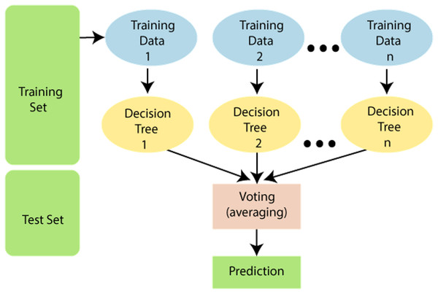
This Photo by Unknown Author is licensed under CC BY

Slide 10
DATA COLLECTION
Data sources:
  Google Earth Engine
  NASA EARTH DARA

Slide 11
DATA PREPROCESSING
Includes:
- Cleaning missing values
- Spatial and temporal alignment
- Feature engineering (lagged rainfall, runoff indices)
- Scaling and normalization

Slide 12
EXPECTED OUTCOME
A localized flood prediction system providing:
  Early warnings (5–10 days ahead)
  Community-level alerts
  Improved disaster management and resilience

Slide 13
CONCLUSION
Flooding in chikwawa is recurrent and severe.- Current systems lack precision and timeliness.
Ml-based system offers localized, accurate, and timely predictions.
Supports anticipatory action, reduces losses, and strengthens resilience.
Sustainable long-term solution for disaster management in the lower shire valley.

Slide 14
REFERENCES
M. A. M. Manyuchi, “Geography of flood risk in the Lower Shire Valley, Malawi,” J. Geogr. Reg. Plan., vol. 12, no. 3, pp. 52–62, 2019, doi: 10.5897/JGRP2019.0732.
M. L. Mul and others, “Hydrological assessment of the 2019 floods in the Lower Shire, Malawi,” Hydrol. Earth Syst. Sci. Discuss., 2020, doi: 10.5194/hess-2020-312.
Government of Malawi, “Malawi 2019 Floods Post Disaster Needs Assessment (PDNA) Report,” Department of Disaster Management Affairs (DoDMA), Lilongwe, May 2019. [Online]. Available: https://www.gfdrr.org/sites/default/files/publication/Malawi_PDNA_2019.pdf
S. S. Refadah, “Development in flood forecasting: A comprehensive review of complex and machine learning models,” Phys. Chem. Earth Parts ABC, p. 103975, 2025.
A. Mosavi, P. Ozturk, and K. Chau, “Flood prediction using machine learning models: Literature review,” Water, vol. 10, no. 11, p. 1536, 2018.
Government of Malawi, “2015 Floods Post Disaster Needs Assessment Report,” Department of Disaster Management Affairs (DoDMA), Lilongwe, 2015.
World Bank, “Malawi Rapid Damage and Loss Assessment: Cyclone Idai,” World Bank Group, Washington, DC, 2019.
United Nations Office for the Coordination of Humanitarian Affairs (UN OCHA), “Malawi: Tropical Cyclone Freddy Flash Appeal,” Mar. 2023. [Online]. Available: https://reliefweb.int/report/malawi/malawi-tropical-cyclone-freddy-flash-appeal-march-2023
M. Reichstein, G. Camps-Valls, B. Stevens, M. Jung, J. Denzler, and N. Carvalhais, “Deep learning and process understanding for data-driven Earth system science,” Nature, vol. 566, pp. 195–204, 2019, doi: 10.1038/s41586-019-0912-1.
Malawi Red Cross Society, “Forecast-based Financing Early Action Protocol – Floods,” Lilongwe, 2022.
A. M. Nyirenda and others, “Machine learning based flood forecasting using multi-source data in Malawi,” Water, vol. 15, no. 8, p. 1492, 2023, doi: 10.3390/w15081492.
Zindi Africa, “Flood Prediction in Southern Africa.” 2021. [Online]. Available: https://zindi.africa/competitions/flood-prediction-in-southern-africa
M. Chibwana, L. Kamwanja, and A. Phiri, “Long-term impacts of the 2019 floods on child nutrition in Chikwawa District,” Malawi Med. J., vol. 33, no. 2, pp. 112–119, 2021, doi: 10.4314/mmj.v33i2.6.

Slide 15
The End

